Slide 1
A Large-Scale Empirical Study on Android Runtime-Permission Rationale Messages
Xueqing Liu¹, Yue Leng¹, Wei Yang², Wenyu Wang¹, Chengxiang Zhai¹, Tao Xie¹
Email: {xliu93,yueleng2,wenyu2,czhai,taoxie}@illinois.edu, wei.yang@utdallas.edu
Notes:
My name is Xueqing,
I’m here to present our work:
Joint work of the data mining and software engineering groups at University of Illinois.

Slide 2

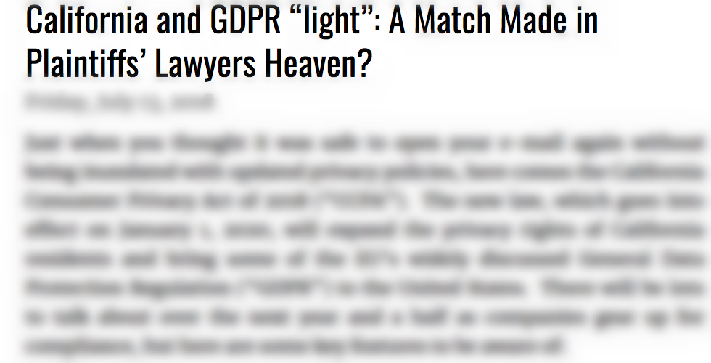
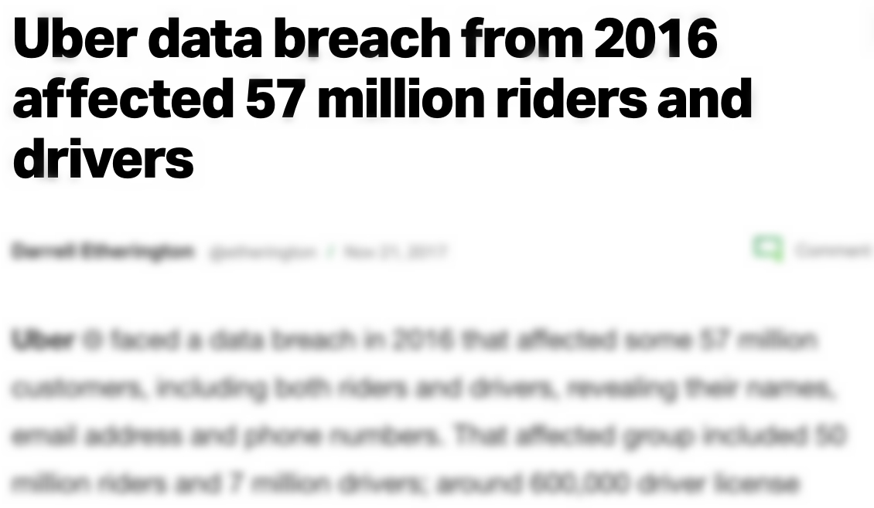
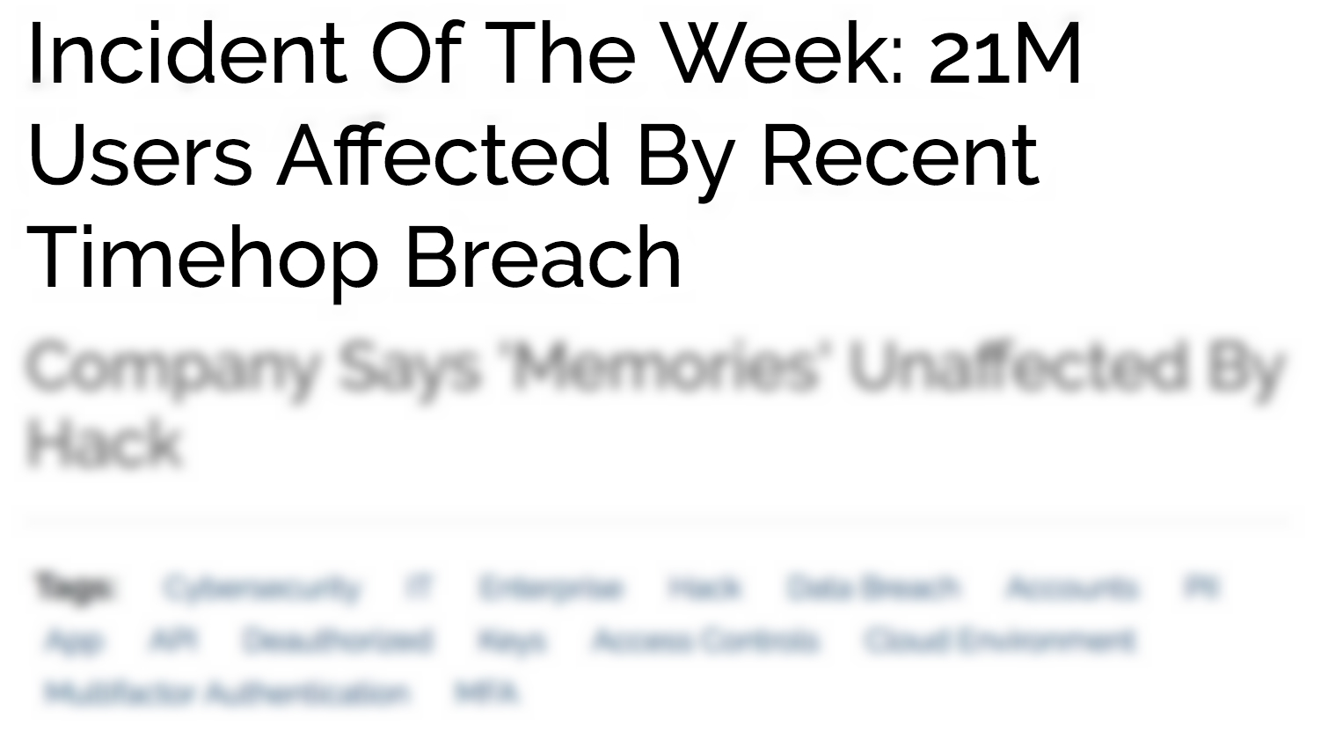
Growing Challenges in Android Privacy
Notes:
As the popularity of smartphones keeps growing, the industry also faces more and more challenges in protecting user privacy.
Earlier this year, we all heard about Cambridge Analytica, the company that harvested 87 million user profiles by requesting access to their Facebook logins.
In recent years, we have seen a lot of similar data breach incidents. Every time, millions of users got their personal information leaked.

Slide 3








Android Permission Requests
Notes:
The way Android protects users’ private information is through the Android permission system.
The permission system controls users’ private data resources such as location, contact list, and so on, and users must grant these permissions before the app can access their information.

Slide 4



Difficulty in Understanding Permissions
Why does Twitter need my storage?
Twitter:
“…to save your profile photo, we need permission to access media on your device ...”
1/3 permissions are not understood [Felt et al. 12]
Reduced users’ security concerns [Lin et al. 12]
Permission: STORAGE
Notes:
However, existing work shows that there’s a knowledge gap between user understanding and the technical permission usage.
Users often don’t understand what the permissions are used for.

Slide 5
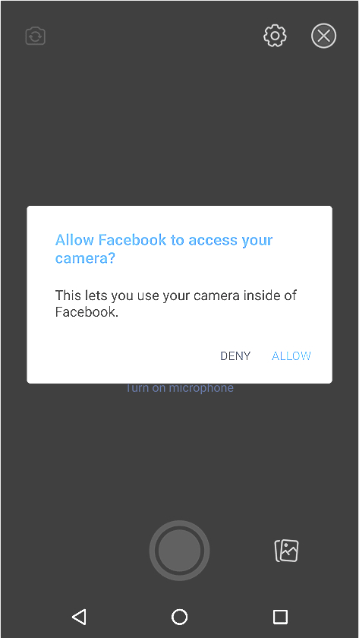
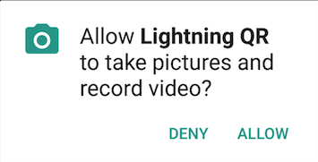
Runtime Permission (Android 6.0 Marshmallow)
Requests permissions at runtime
Advantage: Explain permission requests in contexts
Allow Facebook to take pictures and record video?
Permission: CAMERA
Notes:
The way Android protects users’ private information is through the Android permission system.
The permission system controls users’ private data resources such as location, contact list, and so on, and users must grant these permissions before the app can access their information.

Slide 6
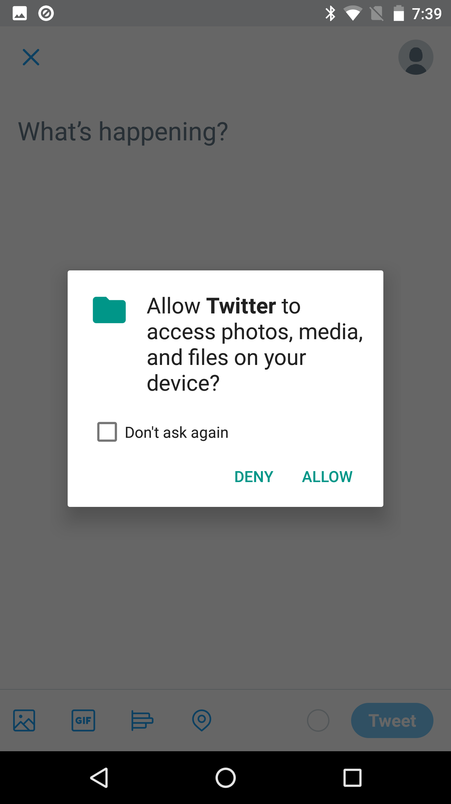
Explain Permissions beyond Contexts
Background usage:
Storage for caching in GPS navigator app
Email address for automatically login
Less visible contexts
Permission: STORAGE
Notes:
The way Android protects users’ private information is through the Android permission system.
The permission system controls users’ private data resources such as location, contact list, and so on, and users must grant these permissions before the app can access their information.

Slide 7
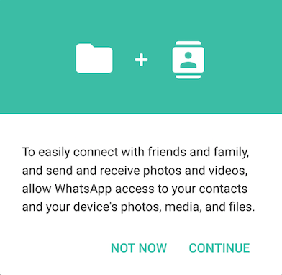
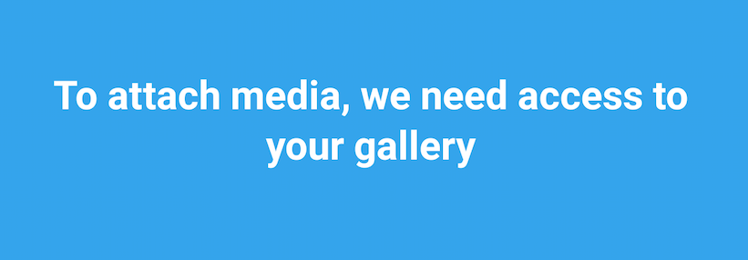


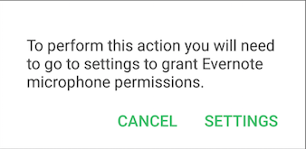



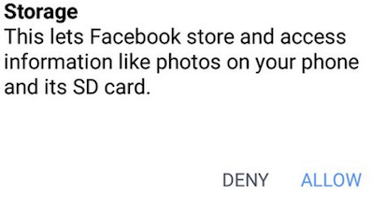
Runtime Permission Rationales (Android 6.0 Marshmallow)
To perform this action you will need to go to settings to grant Evernote storage permissions!
Permission: STORAGE
Notes:
However, existing work shows that there’s a knowledge gap between user understanding and the technical permission usage.
Users often don’t understand what the permissions are used for.

Slide 8
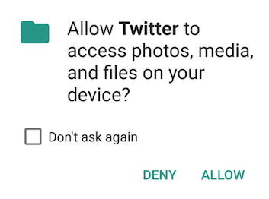
Runtime Permission Rationales
Customized by each app
Displayed immediately before/after permission request or upfront
public void onRequestPermissionsResult
(int requestCode, String[] permissions, int[] grantResults) {
if (requestCode == REQUEST_PERMISSION) {
for (int i = 0, len = permissions.length; i < len; i++) {
String permission = permissions[i];
if (grantResults[i] == PackageManager.PERMISSION_DENIED) {
if (shouldShowRequestPermissionRationale( permission )){
if (Manifest.permission.WRITE_CONTACTS.equals(permission)) {
showRationale(permission, R.string.permission_denied_contacts);
}}}}
Permission-requesting message (same for each permission)
Runtime permission rationale (customized by app)
Notes:
The Berkeley paper only shows that rationales work in theory. In practice, we want to understand when and how an app provide a rationale.
Because the rationales won’t be effective if no apps use it in practice, and only through statistical study can we understand how the rationale feature works at a large scale.
More specifically, we study these four research questions. RQ1 and RQ2 are when questions and RQ3 and RQ4 are how questions.
RQ1 asks how many apps provide rationales, and is there any difference between different permissions?
RQ2 further asks if apps provide more rationales for difficult permissions or for easier permissions?
RQ3 asks if there exist any incorrect rationales
And finally, RQ4 asks about how specific the rationales are.

Slide 9

Motivation
How do apps explain permission purposes?
Permission explanation vs. user expectation
I understand camera needs CAMERA, but why LOCATION?
Camera app uses CAMERA because…
Gap
Notes:
The Berkeley paper only shows that rationales work in theory. In practice, we want to understand when and how an app provide a rationale.
Because the rationales won’t be effective if no apps use it in practice, and only through statistical study can we understand how the rationale feature works at a large scale.
More specifically, we study these four research questions. RQ1 and RQ2 are when questions and RQ3 and RQ4 are how questions.
RQ1 asks how many apps provide rationales, and is there any difference between different permissions?
RQ2 further asks if apps provide more rationales for difficult permissions or for easier permissions?
RQ3 asks if there exist any incorrect rationales
And finally, RQ4 asks about how specific the rationales are.

Slide 10
Empirical Study on Runtime Permission Rationale
RQ1: Which permission is more frequently explained?
RQ2: Are less-straightforward permissions more explained?
RQ3: Do rationales correctly explain the permission?
RQ4: How specific are the explanations?
RQ5: Is explanation in rationales correlated to the explanation in app description?
Notes:
The Berkeley paper only shows that rationales work in theory. In practice, we want to understand when and how an app provide a rationale.
Because the rationales won’t be effective if no apps use it in practice, and only through statistical study can we understand how the rationale feature works at a large scale.
More specifically, we study these four research questions. RQ1 and RQ2 are when questions and RQ3 and RQ4 are how questions.
RQ1 asks how many apps provide rationales, and is there any difference between different permissions?
RQ2 further asks if apps provide more rationales for difficult permissions or for easier permissions?
RQ3 asks if there exist any incorrect rationales
And finally, RQ4 asks about how specific the rationales are.

Slide 11
Data Collection
Crawled 83,244 apps with a runtime permission version (Google Play store and APKPure)
Collect 115,558 rationales from ./res/values/strings.xml
<string name="save_screenshot_permissions_prompt_title">To save your screenshot, we need permission to write to your storage.</string>
<string name="save_screenshot_permissions_prompt_title">To save your screenshot, we need permission to write to your storage.</string>
 | FP | FN
Step 1 | N/A | ~0%
Step 2 | 5.1% | 6.8%
Step 1: keyword matching, e.g., sentences containing “perm”, “toast” (positive)
Step 2: Build 9 CNN sentence classifiers, e.g., STORAGE (positive) vs. not STORAGE (negative)
Permission: STORAGE
Notes:
Our study objects are 80K apps which are under Android 6.0 or higher versions.
From these apps, we use natural language processing techniques to extract permission rationales, altogether we found 100K rationales.
These rationales are for explaining the permission requests in the 9 permission-groups listed in here.
Because the runtime permission is only applied to these 9 permission-groups.

Slide 12
RQ1: Which Permissions are More Frequently Explained?
%
37.7%
25.6%
#apps explaining the permission
%exp =
23.8% apps provide rationales (33.9% in top-500 apps)
y-axis:
#apps using the permission
(explain proportion)
Notes:
So, for the first research question, we find 24% apps in our dataset provides rationales, but this number increase by 10% among the top-500 apps in all the categories in Google Play store.
For the 9 permission-groups, we find that CAMERA and MICROPHONE are the most explained permissions, and PHONE and CONTACTS are the least explained permissions.

Slide 13
RQ2: Less-straightforward permissions more explained?
Users have different expectations for different permissions [Jing et al. CODASPY’14]
e.g., Camera app: expect CAMERA > LOCATION
Google I/O 2015, Android Developers Guide:
Developers should prioritize explaining non-straightforward permission purposes (e.g., camera apps using LOCATION) than straightforward purposes (e.g., camera apps using CAMERA)
URL: https://developer.android.com/reference/android/support/v4/app/ActivityCompat#shouldshowrequestpermissionrationale
Notes:
For the second question, do apps explain difficult permission more often?
The reason for us to study this problem is based on the common understanding that users have different expectations for different permissions.
Some permissions are more difficult to understand than others, even in the same app.
For example, in a camera app (Instagram), user will find the camera permission easier to understand than the location permission.
But in a GPS navigation app (waze), user will find the location permission easy to understand but the camera permission is confusing.
If both the two apps need to select a permission to explain, which one will each of them choose to explain? Would they rather choose the easier one or the difficult one?

Slide 14
RQ2: Less-straightforward permissions more explained? (Cont.)
Quantifying straightforwardness
 | Camera apps | GPS apps
CAMERA | 71.4% | 22.6%
LOCATION | 23.2% | 92.6%
#apps using the permission
%request =
#apps in total
(request proportion)
CAMERA exception: webcam app
https://play.google.com/store/apps/details?id=com.viettelidc.cloudcamera
Notes:
How to represent how difficult a permission is? We find that we can approximate the easiness of using a permission as the proportion of apps using that permission in a group.
For example, among the group that contains all the camera apps, 71.4exapps use the camera permission, and so on. We can see these numbers are consistent with the easiness of understanding these permissions.

Slide 15
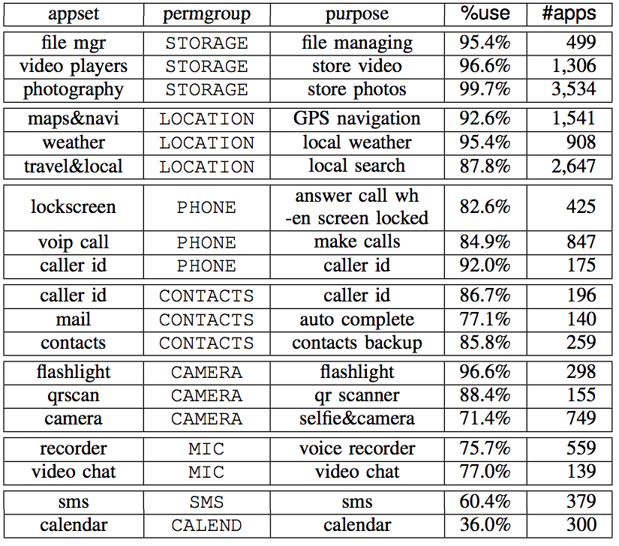
RQ2: Less-straightforward permissions more explained? (Cont.)
App Set
STORAGE
App set
LOCATION
App set
PHONE
App set
CONTACTS
App set
CAMERA
App set
MICROPHONE
App set
SMS
App set
CALENDAR
App set
Notes:
We define 8 app groups. Each app group corresponds to a permission group.
For example, the location app group contains all the GPS navigation apps and all the weather apps.
In average, each of the 8 app groups contain 1,840 apps
We study the correlation between % apps using the permission vs. % apps explaining the permission.

Slide 16
RQ2: Less-straightforward permissions more explained? (Cont.)
App sets
Diagonals are always larger
Diagonals are almost always larger
% request
Positively correlation
% explain
Average of off-diagonal
permissions
Notes:
We show the correlation using the two plots.
For the two plots, each row corresponds to an app group and each column corresponds to a permission-group.
So, for example, this number 0.23 is how often the location apps use the camera permission, and this number 0.25 is how often the location apps explain the camera permission.
In the non-diagonal column and row, we show the average over all the non-diagonal cells.
If we compare the diagonal number with the non-diagonal number on the right figure, we can clearly see that the % explain permission in the diagonal is usually higher than the number in the non-diagonal, e.g., the location permission is explained more frequently in the location apps (0.32) than in other apps (0.24)
What these numbers tells us is that in average, permissions are explained more in easier permissions than in difficult permissions
But there are a few exceptions, e.g., microphone is frequently explained in camera apps (0.33)

Slide 17
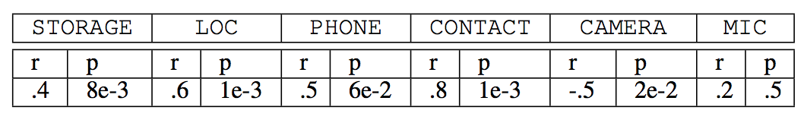
RQ2: Less-straightforward permissions more explained? (Cont.)
Measuring the correlation among all apps
Divide all apps into 35 app sets based on Google Playstore category
For each app set, compute its %request and %exp for each permission
For 4/6 permissions, %request and %exp are significantly positively correlated
In most cases, app more frequently explain straightforward permissions

Slide 18
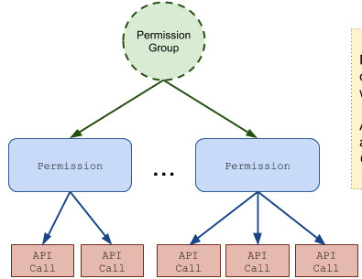
RQ3: Do rationales correctly explain the permission?
Estimate the population of incorrect rationales, i.e., stated purpose ≠ actual purpose?
Representing purpose by leveraging hierarchical structure of permission group
CONTACTS
GET_ACCOUNTS
READ_CONTACTS
Android 6.0 – 8.1
Notes:
We move on to study of the how questions, the third question in our study is, does there exist any incorrect rationales?
We observe that incorrect rationales can happen when one app-group controls multiple permissions at the same time.
For example, the PHONE permission-group controls 9 permissions, and the 9 permissions control quite different functionalities
For example, these two permission control the read phone state permission, these two allows the app to make calls, and these two control user’s call log

Slide 19

RQ3: Do rationales correctly explain the permission? (Cont.)
Under-claimed case, permission = PHONE
Make user falsely believe the app cannot make phone call
CALL_PHONE
READ_PHONE_STATE
“We need to read your phone state to pause the music when receiving incoming calls”
URL: https://play.google.com/store/apps/details?id=com.airkast.WJOXFM&hl=en_US
Notes:
So the answer to the third research question is yes, there are incorrect rationales.

Slide 20

RQ3: Do rationales correctly explain the permission? (Cont.)
Over-claimed case, permission = CONTACTS
Confusing users by requesting permission unrelated to functionality
GET_ACCOUNTS
“Permission to contacts is required to use voice commands to call text someone from your contacts”
URL: https://apkdownloadforandroid.com/com.applepie4.mylittlepet.m.p1016/
Notes:
So the answer to the third research question is yes, there are incorrect rationales.

Slide 21
RQ3: Do rationales correctly explain the permission? (Cont.)
Identifying under-claimed cases and over-claimed cases (classified by CNN, verified manually)
 | CONTACTS | PHONE | LOCATION
Under-claimed | 4.6% | 11.3% | 0.1%
Over-claimed | 13.2% | 4.2% | 0.6%
There exists a significant proportion of incorrect rationales!
Notes:
We use a CNN sentence classifier to identify case 1 and case 2.
And we find that for the PHONE permission, there’s actually 11.3% apps which claims they only use the phone state permission, but they have requested other permissions.
There are also 13.2% apps that only request the access to get users’ account, but they claim they use the users’ contact information.

Slide 22
RQ4: How specific are the explanations?
Specificity is related to convincingness
Is a rationale more specific than the permission-requesting message?
Runtime permission rationale (customized by app)
Permission-requesting message (fixed)
Notes:
Finally, for the last research question, we study how specific are the rationale sentences.
Notice no matter the app provide rationales or not, the user can already see this message: “allow facebook to access this device’s location”
So if the rationale just repeat this information, it doesn’t make much more sense on top of that.
A specific rationale should be like this one, by containing some words that describe the specific purpose.

Slide 23
RQ4: How specific are the explanations? (Cont.)
Identifying specific rationales => Named entity recognition (NER)
Stanford NER tagger for each permission, accuracy 85%~94%
Ex. 1. This_O radio_O application_O would_O like_O to_O use_O the_O phone_O permission_O to_S pause_S the_S radio_S when_S receiving_S incoming_S calls_S (specific)
Ex. 2. This_O application_O cannot_O proceed_O without_O access_O to_O the_O phone_O permission_O (non-specific)
Notes:
Finally, for the last research question, we study how specific are the rationale sentences.
Notice no matter the app provide rationales or not, the user can already see this message: “allow facebook to access this device’s location”
So if the rationale just repeat this information, it doesn’t make much more sense on top of that.
A specific rationale should be like this one, by containing some words that describe the specific purpose.

Slide 24
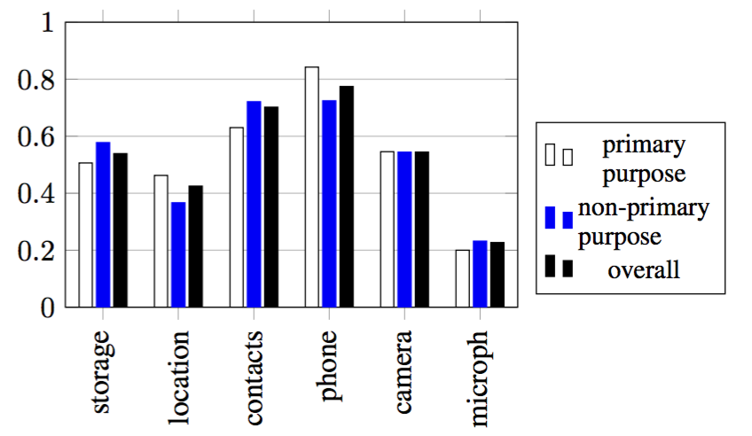
RQ4: How specific are the explanations? (Cont.)
100%
80
60
% specific rationale
40
20
22% - 77% apps provide no more information than permission-requesting message
Notes:
To find specific rationales, we train a Stanford NER tagger.
The value in this table shows the proportion of specific rationales for each permission.
For example, only 25% of the microphone rationales are specifically explained.

Slide 25
Recap for RQ1 – RQ4
RQ1: 23.8% apps provide rationales, PHONE and CONTACTS are least explained
RQ2: more apps prioritize explaining straightforward permissions than less straightforward permissions
RQ3: there exists significant proportion of incorrect rationales in PHONE and CONTACTS
RQ4: 22%-77% rationales are only repeating the permission-requesting message
Notes:
Our second research question finds that apps prefer explaining easier permissions than difficult permissions, why is this the case?
First, it may be because some unexplained permissions are over-privileged ones that apps cannot justify.
The second possibility is that rare permissions are too difficult to explain, like if you tell the user that camera permission is for camera they will understand, but if you tell them the camera permission in a GPS app is for augmented reality, they get lost, so developer just skip these explanations.
The third possibility is that developers are just lazy, and they prefer explaining permissions that are easy to themselves, and they forget about if users feel it’s difficult to understand

Slide 26
Implication from RQ3 (incorrect rationales)
PHONE: 10 diverse fine-grained permissions:
READ_PHONE_STATE
READ_PHONE_NUMBERS
CALL_PHONE
ANSWER_PHONE_CALLS
ADD_VOICEMAILS
USE_SIP
READ_CALL_LOG
WRITE_CALL_LOG
PROCESS_OUTGOING_CALLS
Increases the difficulty for understanding/explaining the permission
phone state
making calls
Allow finer-grained control from user’s side?
call log
July 31rd
Sept 10
Notes:
So the answer to the third research question is yes, there are incorrect rationales.

Slide 27
Implication from RQ1, RQ2, and RQ4
Less straightforward permissions are insufficiently explained
Explained permissions are not more informative than permission-requesting message
Official guidelines/Recommender system
Recommend which permissions are non-straightforward
Recommending example sentences for explaining permissions
Notes:
Our second research question finds that apps prefer explaining easier permissions than difficult permissions, why is this the case?
First, it may be because some unexplained permissions are over-privileged ones that apps cannot justify.
The second possibility is that rare permissions are too difficult to explain, like if you tell the user that camera permission is for camera they will understand, but if you tell them the camera permission in a GPS app is for augmented reality, they get lost, so developer just skip these explanations.
The third possibility is that developers are just lazy, and they prefer explaining permissions that are easy to themselves, and they forget about if users feel it’s difficult to understand

Slide 28
Threats to Validity
Internal validity:
Selection bias: misclassification results of classifier/NER tagger, manual inspection
External validity:
Generality of the crawled apps from Google Playstore and APKPURE

Slide 29
Thank you!
Acknowledgment: NSF CNS-1513939, NSF CNS-1408944, NSF CCF-1409423, and NSF CNS-1564274
Rationale dataset available at: https://sites.google.com/view/runtimepermissionproject/

Slide 30
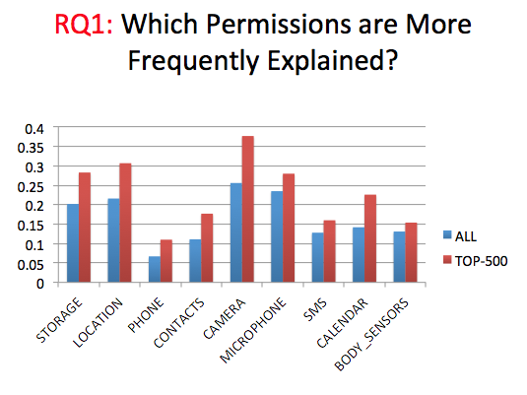
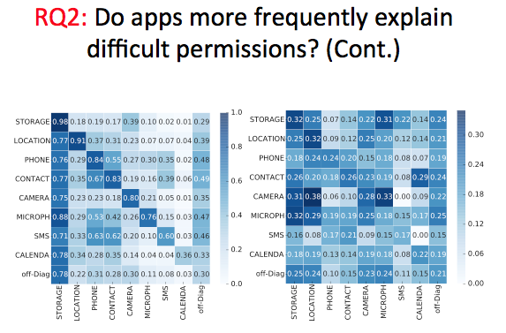
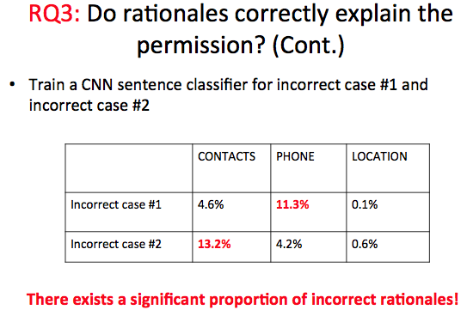
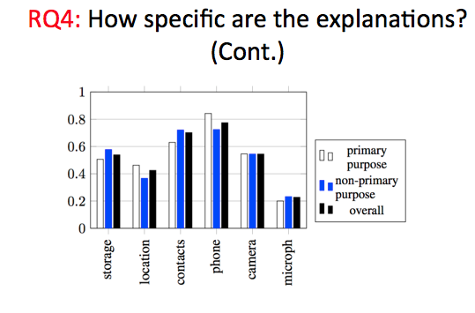
Conclusion

